Slide 1

AURORA BANK
REPORT
Prepared by Lan Chi

Slide 2

CONTENTS
Introduce
Dataset
Dashboard & Insights
Limitations
Data Preparation
1
2
3
4
5

Slide 3



1. Introduce
a) What is Aurora Bank?
Aurora Bank is a retail bank.
b) Context
During digital transformation, the bank must balance revenue growth through card spending with bad debt risk management
c) Objective: Leverage transaction logs, KYC data, and credit history to build a management dashboard supporting:
Credit limit decisions
Personalized marketing
Financial fraud detection

Slide 4
2. Dataset
Transaction Table
Column Name | Meaning
id (Primary Key) | Unique identifier for each transaction.
date | Date of the transaction.
client_id (Foreign Key to users_data.id) | Identifier linking the transaction to the user in the users_data table.
card_id (Foreign Key to cards_data.id) | Identifier linking the transaction to the respective card in the cards_data table.
amount | Transaction amount in the respective currency.
use_chip | Boolean/Flag indicating if the chip was used during the transaction.
merchant_id | Unique identifier of the merchant.
merchant_city | City where the merchant is located.
merchant_state | State where the merchant is located.
zip | ZIP code of the merchant's location.
mcc (Foreign Key to mcc_codes.mcc_id) | Merchant Category Code representing the type of merchant or transaction.
errors | Any errors encountered during the transaction (if any).

Slide 5
2. Dataset
Cards Table
Column Name | Meaning
id (Primary Key) | Unique identifier for each credit card.
client_id (Foreign Key to users_data.id) | Identifier linking the card to its owner in the users_data table.
card_brand | Brand or issuer of the credit card (e.g., Visa, Mastercard).
card_type | Type/category of the card (e.g., debit, credit, etc.).
card_number | Unique number on the credit card.
expires | Expiry date of the credit card.
cvv | Security code of the card.
has_chip | Boolean/Flag indicating if the card has an EMV chip.
num_cards_issued | Total number of cards issued for the same account.
credit_limit | Credit limit assigned to the card.
acct_open_date | Date the credit card account was opened.
year_pin_last_changed | Year the card’s PIN was last changed.

Slide 6
2. Dataset
Users Table
Column Name | Meaning
id (Primary Key) | Unique identifier for each user.
current_age | Current age of the user.
retirement_age | Declared retirement age of the user.
birth_year | Year of birth for the user.
birth_month | Month of birth for the user.
gender | Gender of the user ( male or female).
address | Residential address of the user.
latitude | Latitude of the user’s residence.
longitude | Longitude of the user’s residence.
per_capita_income | Per capita income of the user.
yearly_income | Total yearly income of the user.
total_debt | Total amount of debt owed by the user.
credit_score | Credit score rating of the user.
num_credit_cards | Number of credit cards owned by the user.

Slide 7
2. Dataset
Mcc_codes Table
Column Name | Meaning
mcc_id (Primary Key) | Unique identifier for each Merchant Category Code.
Description | Description of the merchant category (e.g., grocery, travel, entertainment).

Slide 8
2. Dataset
Additional Tables
Customer Summary Table
Client_id
Credit Transaction Count
Transaction Count
Credit Usage Rate
Credit Transaction Count Group
Active Month
Stable Activity
Transaction Count per Customer
Transaction Count Group
Customer Error Transaction
Customer Error Rate
Date Table
Date
Year
Month No
Month
Quarter
Year-Month
Transactions_error Table
Transaction_id
Error_type
Client_id

Slide 9
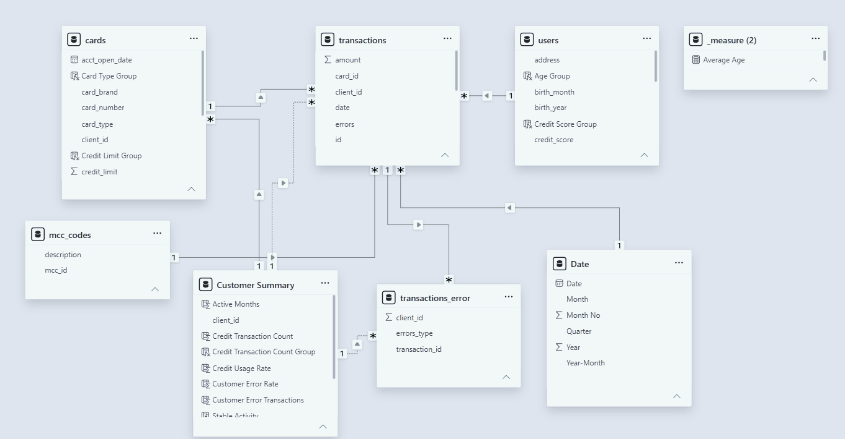
2. Dataset
Data model

Slide 10
3. Data Preparation
Transaction Table
P95
P99
Transaction Value Group
Normal
High Value
Extreme Value
Cards Table
Q1 = 25%
Q2 = 50%
Q3 = 75%
Credit Limit Group
Low
Credit Limit
Medium
Credit Limit
High
Credit Limit
Credit
Card Type Group
Debit
Debit
Debit (prepaid)

Slide 11

3. Data Preparation
Users Table
580
670
710
850
Credit Score
Poor
Fair
Good
Very Good
Excellent
29
44
65
Age Group
Gen Z
Adults
Middle-aged
Old Elderly
Q1 = 25%
Q2 = 50%
P90 = 90%
Income Group
Low Income
Middle Income
Upper Income
High-net-worth
DTI = $\frac{total debt}{yearly_income}$

Slide 12


3. Data Preparation
Customer Summary Table
Credit Usage Rate = $\frac{\text{Credit} \text{Transaction} \text{Count}}{\text{Transaction} \text{Count}}$
Customer Error Rate = $\frac{\text{Customer} \text{Error} \text{Transaction} }{\text{Transaction} \text{Count}}$
0
100
500
Credit Transaction Count Group
No Usage
Low Usage
High Usage
Q1 = 25%
Q2 = 50%
Q3 = 75%
Transaction Count Group
Low
Frequency
Moderate Frequency
High
Frequency
Very High
Frequency
Stable Activity
Active Months = 30
Not Stable
Stable

Slide 13
Dax Measures
a) Customer & Profiling Metrics
Metric | Formula / Logic | Purpose
Total Customers | DISTINCTCOUNT(users[id]) | Total number of customers
Average Age | AVERAGE(users[current_age]) | Average customer age
High-net-worth Customer Count | Count customers classified as High-net-worth | Identify the size of the high-income customer segment
b) Transaction Performance Metrics
Metric | Formula / Logic | Purpose
Total Transaction Amount | SUM(transactions[amount]) | Total transaction value
Transaction Count | COUNTROWS(transactions) | Total number of transactions
Average Transactions per Customer | DIVIDE([Transaction Count], [Total Customers], 0) | Average transaction frequency per customer
Spending Share | DIVIDE([Total Transaction Amount], Total Amount in selected context, 0) | Measure the contribution of each segment/category to total spending
Transaction Amount MoM | Current Month − Previous Month | Track month-over-month transaction value changes

Slide 14
Dax Measures
c) Transaction Frequency Metrics
Metric | Formula / Logic | Purpose
Transaction Count Q1 | 25th percentile of customer transaction count | Lower frequency threshold
Transaction Count Median | Median customer transaction count | Central frequency benchmark
Transaction Count Q3 | 75th percentile of customer transaction count | Higher frequency threshold
Transaction Count Group | Q1 / Median / Q3-based classification | Segment customers into Low, Moderate, High and Very High Frequency
Classification
Condition | Group
< Q1 | Low Frequency
Q1 – < Median | Moderate Frequency
Median – < Q3 | High Frequency
≥ Q3 | Very High Frequency
This is better than arbitrary ranges because the thresholds are data-driven.

Slide 15
Dax Measures
d) Error & Transaction Quality Metrics
Metric | Formula / Logic | Purpose
Error Transactions | DISTINCTCOUNT(transactions_error[id]) where error exists | Number of transactions with errors
Overall Error Rate | DIVIDE([Error Transactions], [Transaction Count], 0) | Overall proportion of erroneous transactions
Bad PIN Transaction Count | Count transactions where errors_type = "Bad PIN" | Number of Bad PIN errors
Bad PIN Rate | DIVIDE([Bad PIN Transaction Count], [Transaction Count], 0) | Bad PIN error rate
Insufficient Balance Transaction Count | Count transactions where errors_type = "Insufficient Balance" | Number of insufficient-balance errors
Insufficient Balance Rate | DIVIDE([Insufficient Balance Transaction Count], [Transaction Count], 0) | Insufficient-balance error rate

Slide 16
Dax Measures
e) Risk & Abnormal Transaction Metrics
Metric | Formula / Logic | Purpose
P99 Transaction Amount | 99th percentile of transaction amount | Establish threshold for unusually high-value transactions
Extreme Transaction Count | Count transactions where Amount > P99 | Identify unusually high-value transactions
Extreme transactions are treated as abnormal-value transactions, not automatically classified as fraud.
f) Geographic & Merchant Metrics
Metric | Formula / Logic | Purpose
Total Transaction Amount by City | [Total Transaction Amount] by Merchant City | Identify cities with the highest purchasing power
Top 5 Merchant Cities | Rank cities by [Total Transaction Amount] | Highlight the strongest geographic markets
Top 5 Merchant Categories | Rank MCC categories by [Total Transaction Amount] | Identify categories generating the highest spending

Slide 17
Dax Measures
g) Growth Metrics
Metric | Formula / Logic | Purpose
Transaction Amount YoY | (Current Year − Previous Year) / Previous Year | Measure annual transaction value growth
Transaction Count YoY | (Current Year − Previous Year) / Previous Year | Measure annual transaction volume growth
Average Transactions per Customer YoY | (Current − Previous) / Previous | Measure annual change in customer activity
Error Transactions YoY | (Current − Previous) / Previous | Monitor annual change in error volume
Overall Error Rate YoY | (Current − Previous) / Previous | Monitor annual change in transaction quality
Bad PIN Rate YoY | (Current − Previous) / Previous | Monitor Bad PIN trend
Insufficient Balance Rate YoY | (Current − Previous) / Previous | Monitor insufficient-balance trend

Slide 18
4. Dashboards and Insights
1. What are the characteristics of High-net-worth customers?
High-net-worth customers are mainly concentrated in the Middle-aged and Adults groups, with most having Good or Very Good Credit Scores, indicating relatively strong financial capacity and credit quality.
2. How does spending differ between Gen Z and Middle-aged customers?
Middle-aged customers spend significantly more than Gen Z across most Merchant Categories, particularly in Money Transfer, Grocery Stores & Supermarkets, and Wholesale Clubs.
3. Which Merchant Categories have the highest spending?
Money Transfer has the highest transaction value, followed by Grocery Stores & Supermarkets and Wholesale Clubs.
4. Why do some Merchant Categories have higher error rates?
Transaction errors are concentrated in categories such as Service Stations and Miscellaneous Food Stores. Insufficient Balance is the most common error, suggesting that part of the transaction issues may be related to customers' payment capacity.

Slide 19
4. Dashboards and Insights
5. Do customers use Debit or Credit Cards more?
Debit Cards account for 69.4% of transactions, significantly higher than Credit Cards (30.6%). Customers with good credit scores but low Credit Card usage represent a potential target for increasing Credit Card adoption.
6. Which area has the highest purchasing power?
Houston has the highest total transaction value among the analyzed Merchant Cities, indicating particularly strong purchasing activity in this market.
7. Which customers are suitable for VIP Care?
Customers in the Top 10% by income, with stable transaction history, high transaction frequency, and below-average error rates are identified as VIP Candidates. This group mainly has Good/Very Good Credit Scores and is concentrated among Middle-aged and Adults.

Slide 20
4. Dashboards and Insights
8. Which customers have high credit risk?
Customers with DTI > 40% combined with low Credit Scores are identified as an early-warning group due to high debt burden and weaker credit quality.
9. Are there unusually high-value transactions?
P99 is used to identify extreme-value transactions. These transactions are concentrated in categories such as Insurance Sales & Underwriting, Travel Agencies, and Legal Services & Attorneys. They should be investigated further but should not automatically be classified as fraud.
10. Can the bank recommend credit-limit increases for customers with positive income growth and settled debt?
Not directly with the available data. The dataset does not contain historical income records or loan settlement status. These additional data sources are required before making a reliable credit-limit adjustment recommendation.

Slide 21
Overall Insights
Middle-aged/Adult and high-income customers represent the bank's most valuable segments, while Credit Card usage still has room for growth.
From a risk perspective, high DTI, Insufficient Balance, and P99 transactions are key signals that should be prioritized for monitoring.

Slide 22
Thank you!

